Slide 1
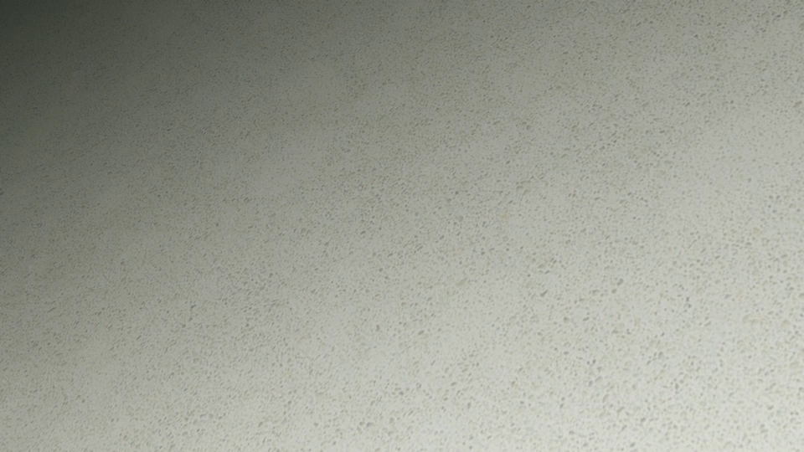
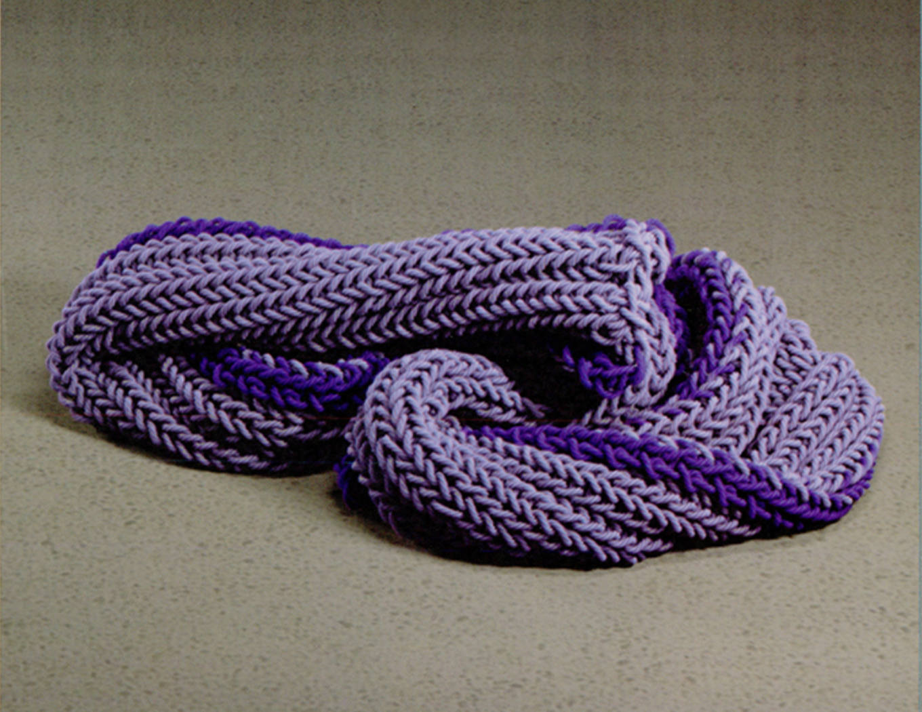
History of Graphics
Rendering Knitting Texture and Properties
I chose this paper because, as someone who knits, I found it compelling how accurately it represents real knit structures and their behavior. What makes this work groundbreaking is that it simulates knitted cloth at the yarn level, rather than treating fabric as a flat elastic sheet. By explicitly modeling individual yarns and their interlocking loops, the simulation naturally reproduces characteristic knit behaviors such as stretching, curling, and realistic motion under gravity. This approach is especially effective in dynamic scenes like a knit dropping, as seen in the rendered video.
Simulating Knitted Cloth at the Yarn Level
Jonathan M. Kaldor, Doug L. James, and Steve Marschner SIGGRAPH 2008
Elli Lopez

Slide 2
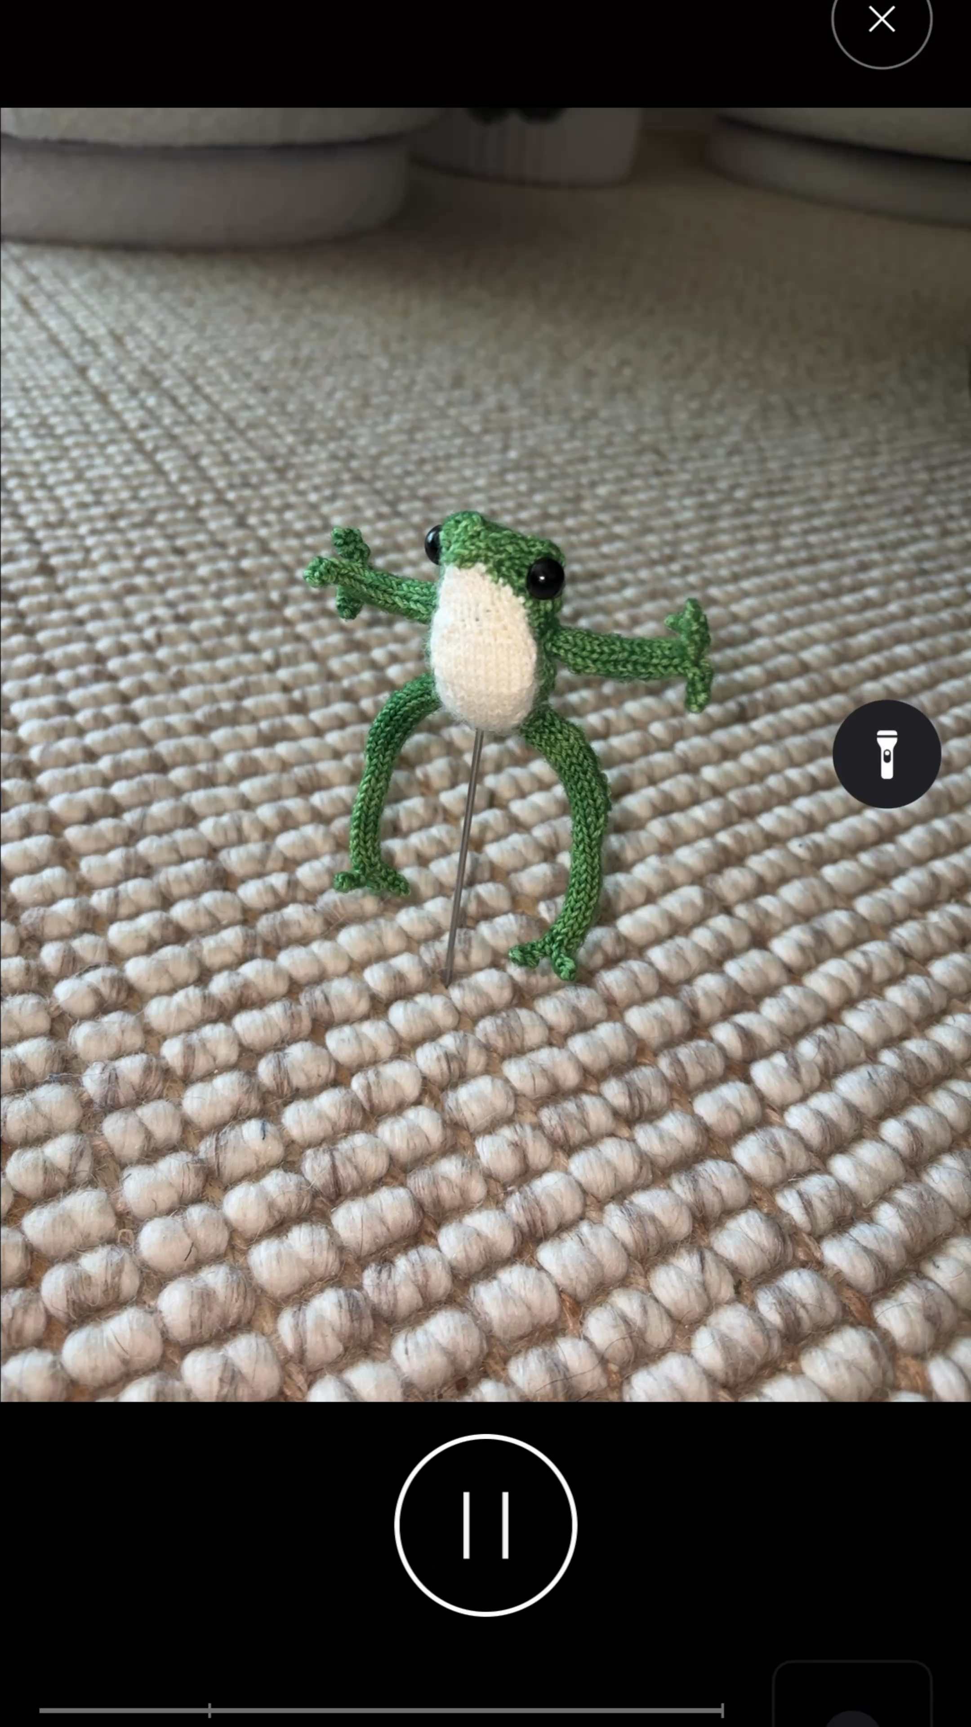
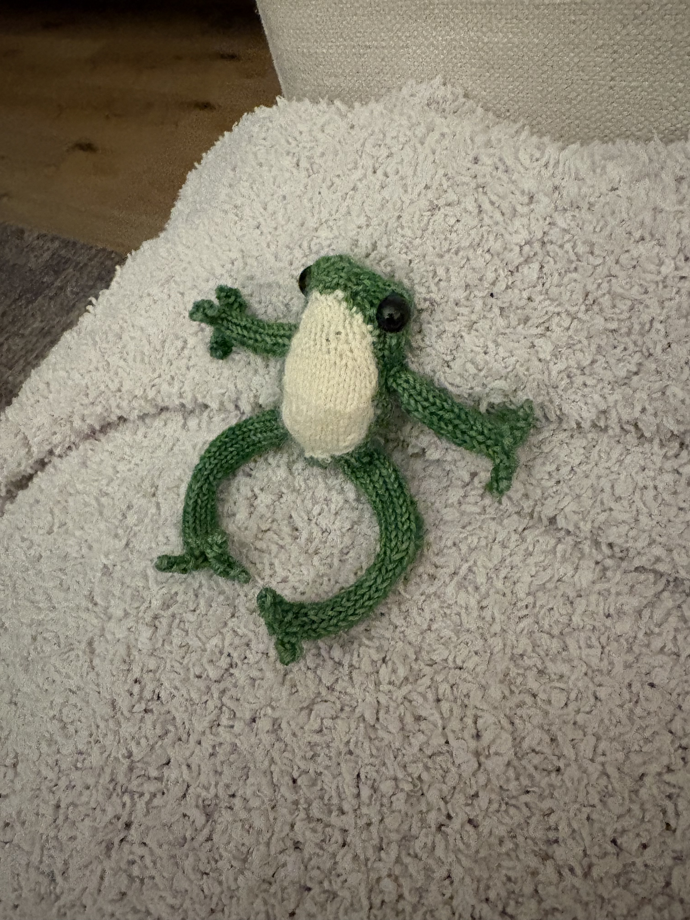
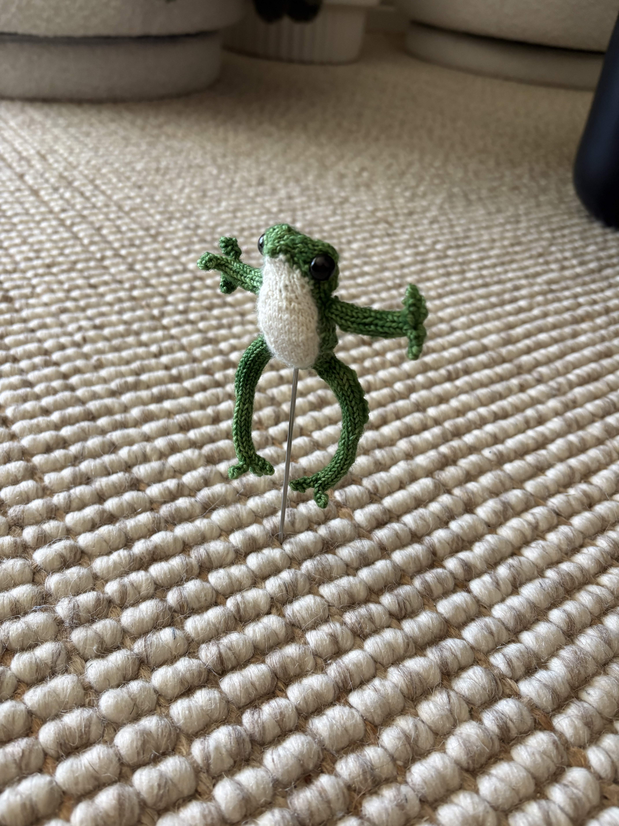
Creating a Mesh
To stay on theme, I decided to knit a tiny frog and use PolyCam to create a custom mesh (OBJ file)
Elli Lopez

Slide 3
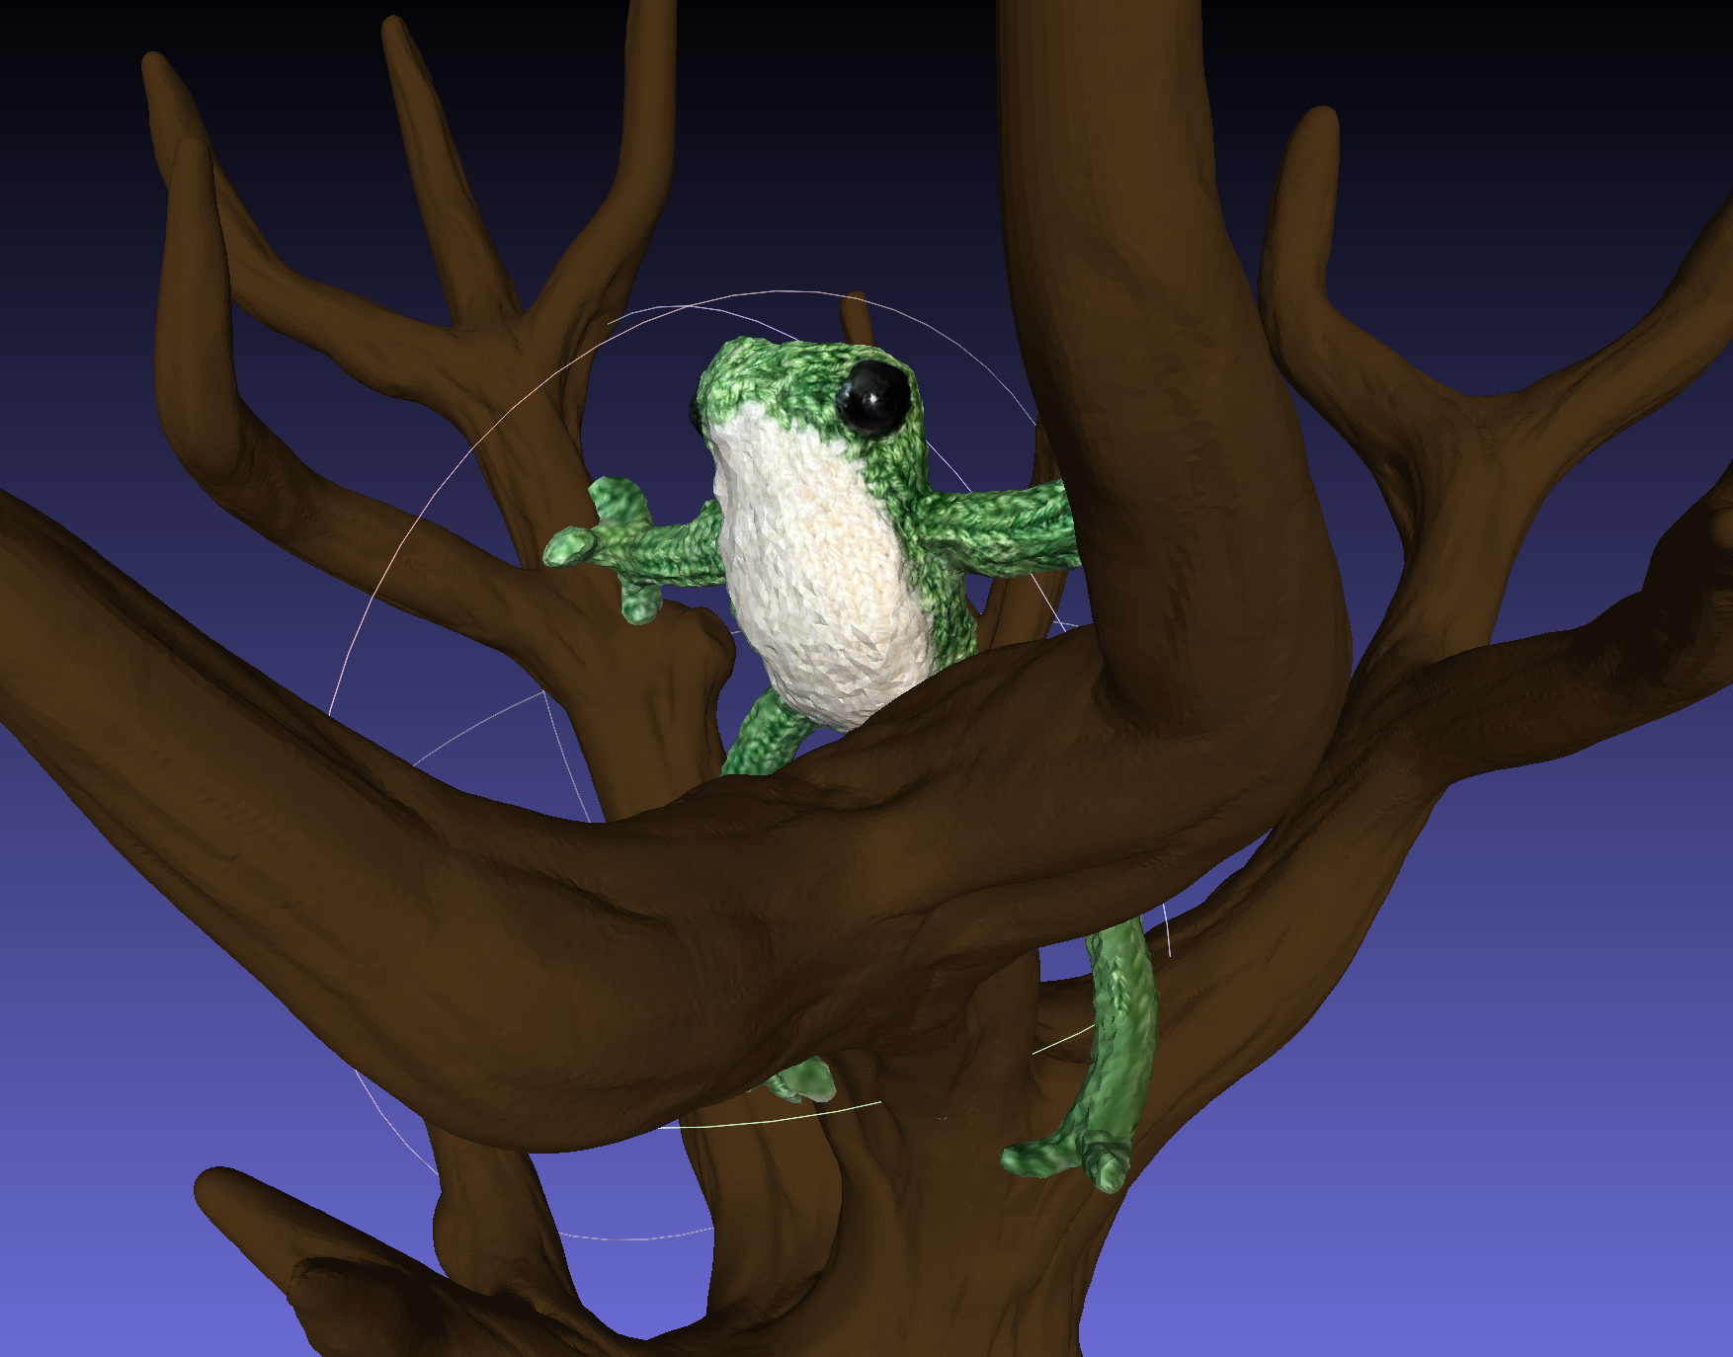
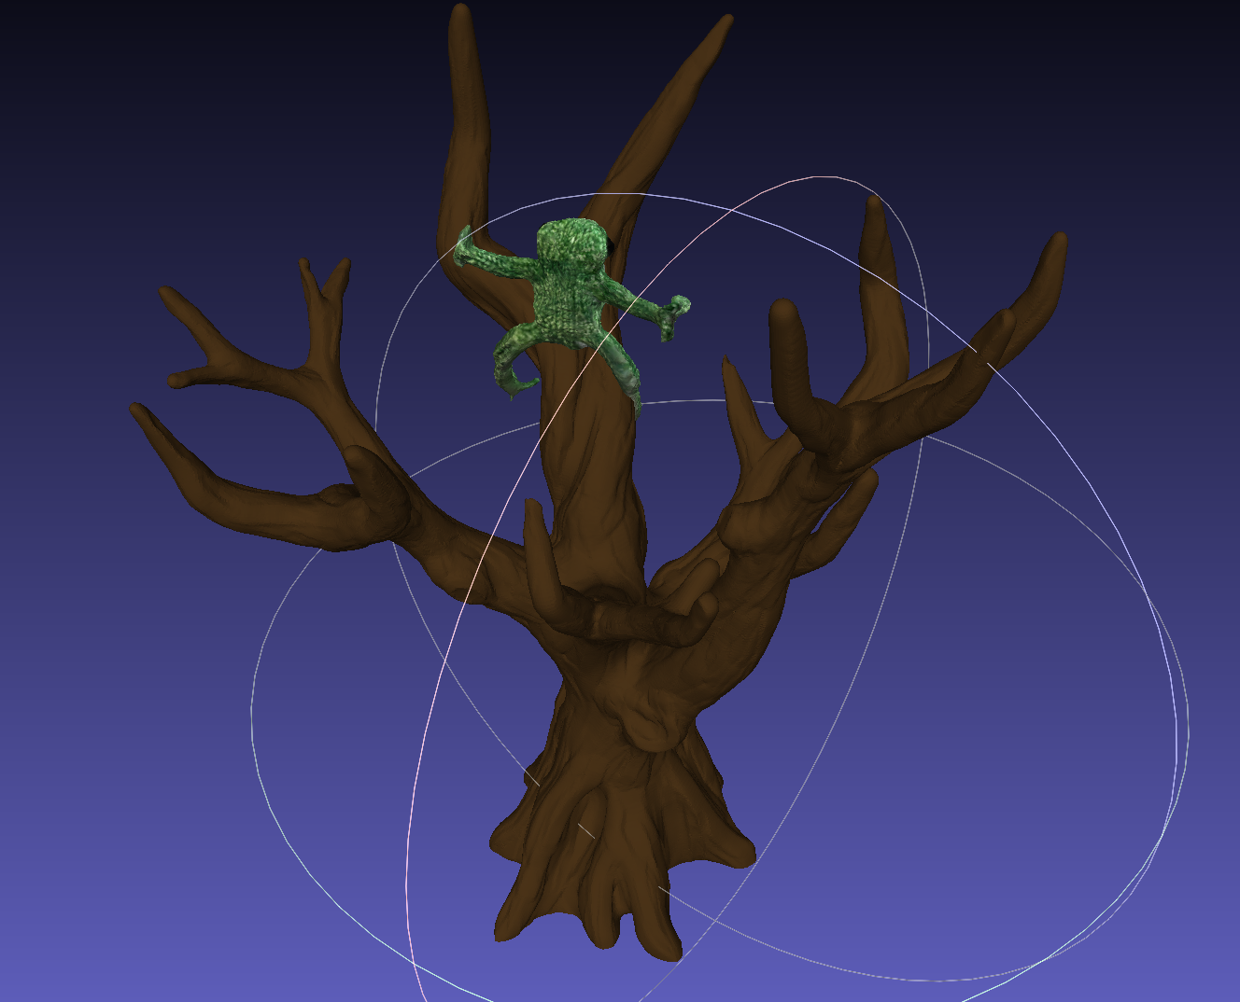
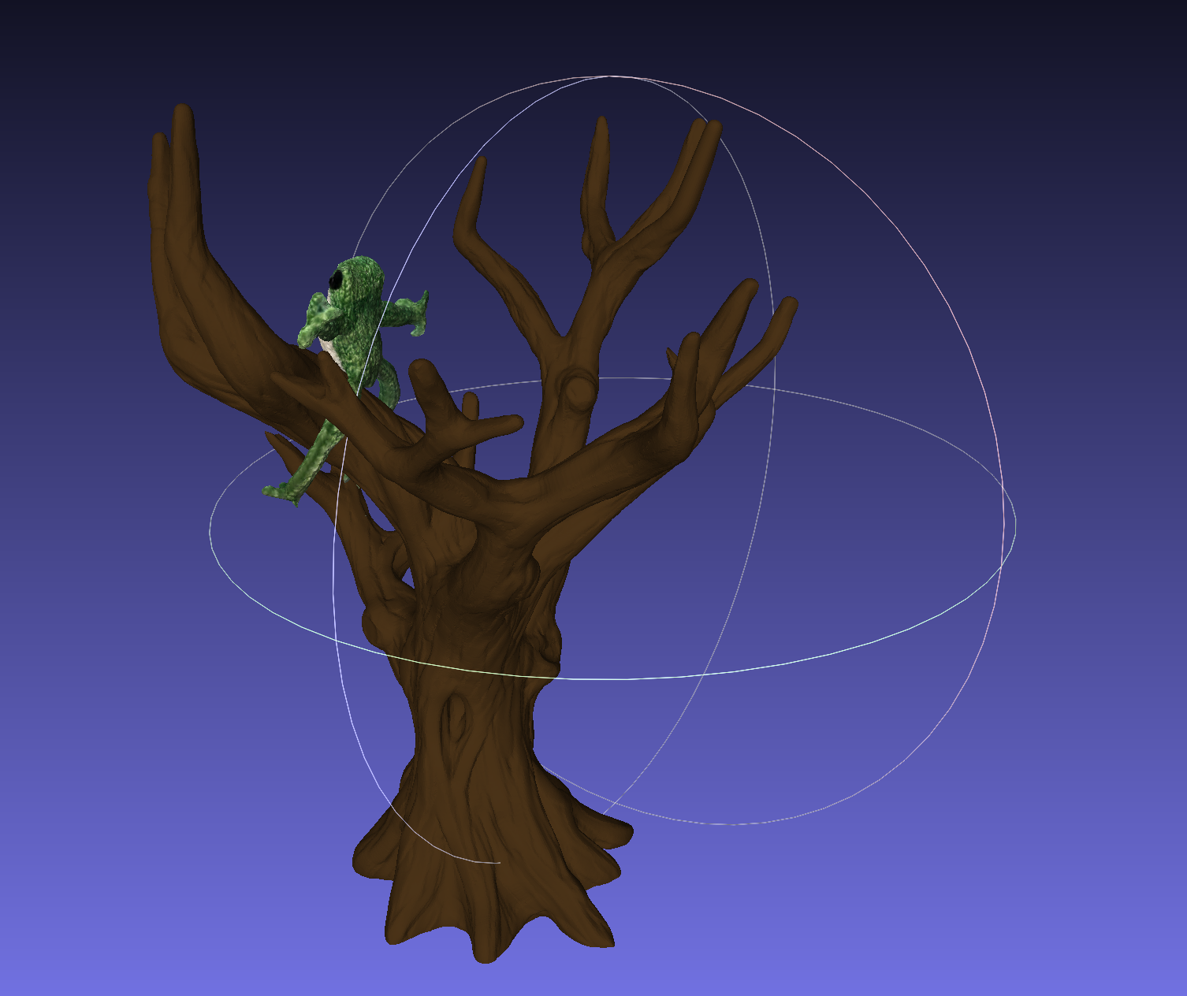
Viewing the Mesh
I then used MeshLab to import my PolyCam frog mesh, and also added another OBJ file of a tree from odedstein’s GitHub repository. Now the frog has climbed the tree!
Elli Lopez

